Slide 1
JCU MA5851 Data Science Master Class 1
Assignment 3
Document 4: Assignment Video Presentation
Student: Sacha Schwab
Date: 8 December 2021

Slide 2















1. Project Overview
Project
Webcrawler
csv
Preprocessor
NLP Engine
Structure &
Save
Text cleaning
Keyword
parser
Clustering
Parser
Tokenizer
Entity
detector
model.pickle
html
Collector
Vectorizer
Sentiment
detector
Further use e.g. Quant Analytics
WWW (Yahoo Finance)

Slide 3
2. Artifacts

Slide 4
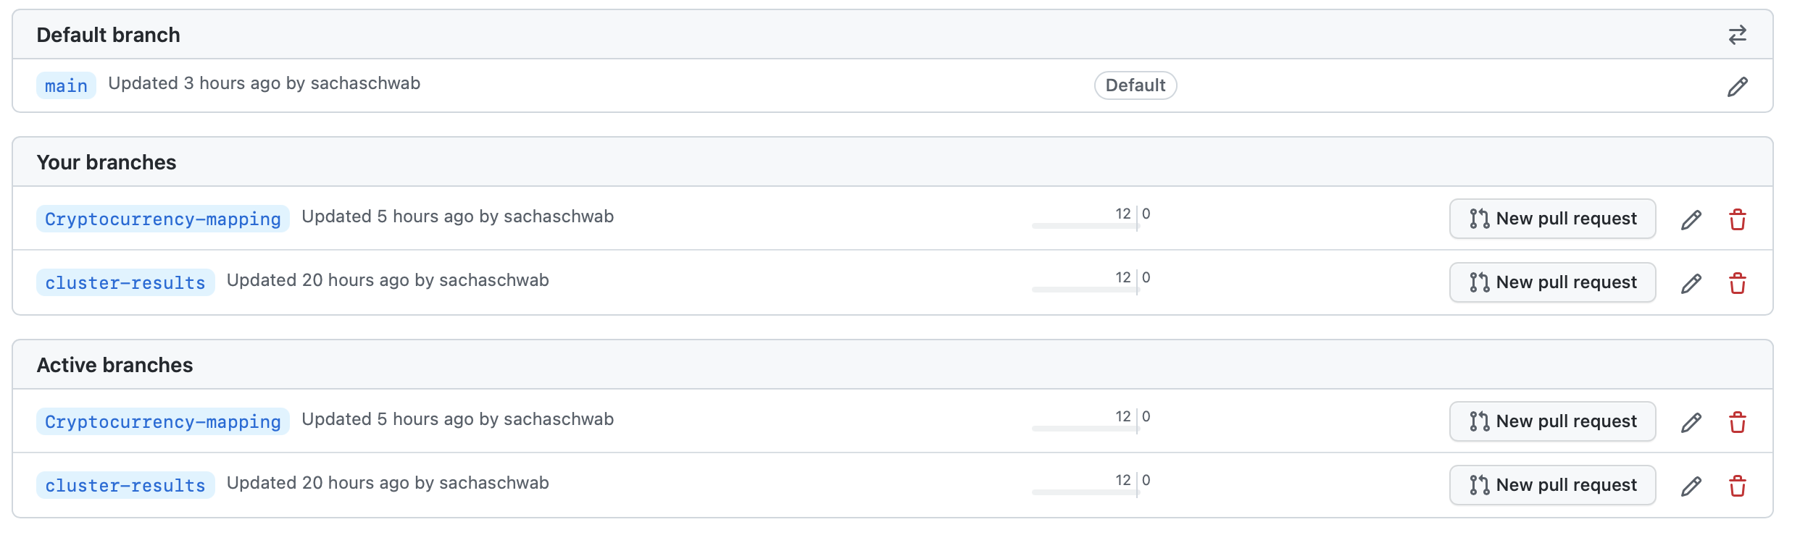
3. Code Management - Branches

Slide 5
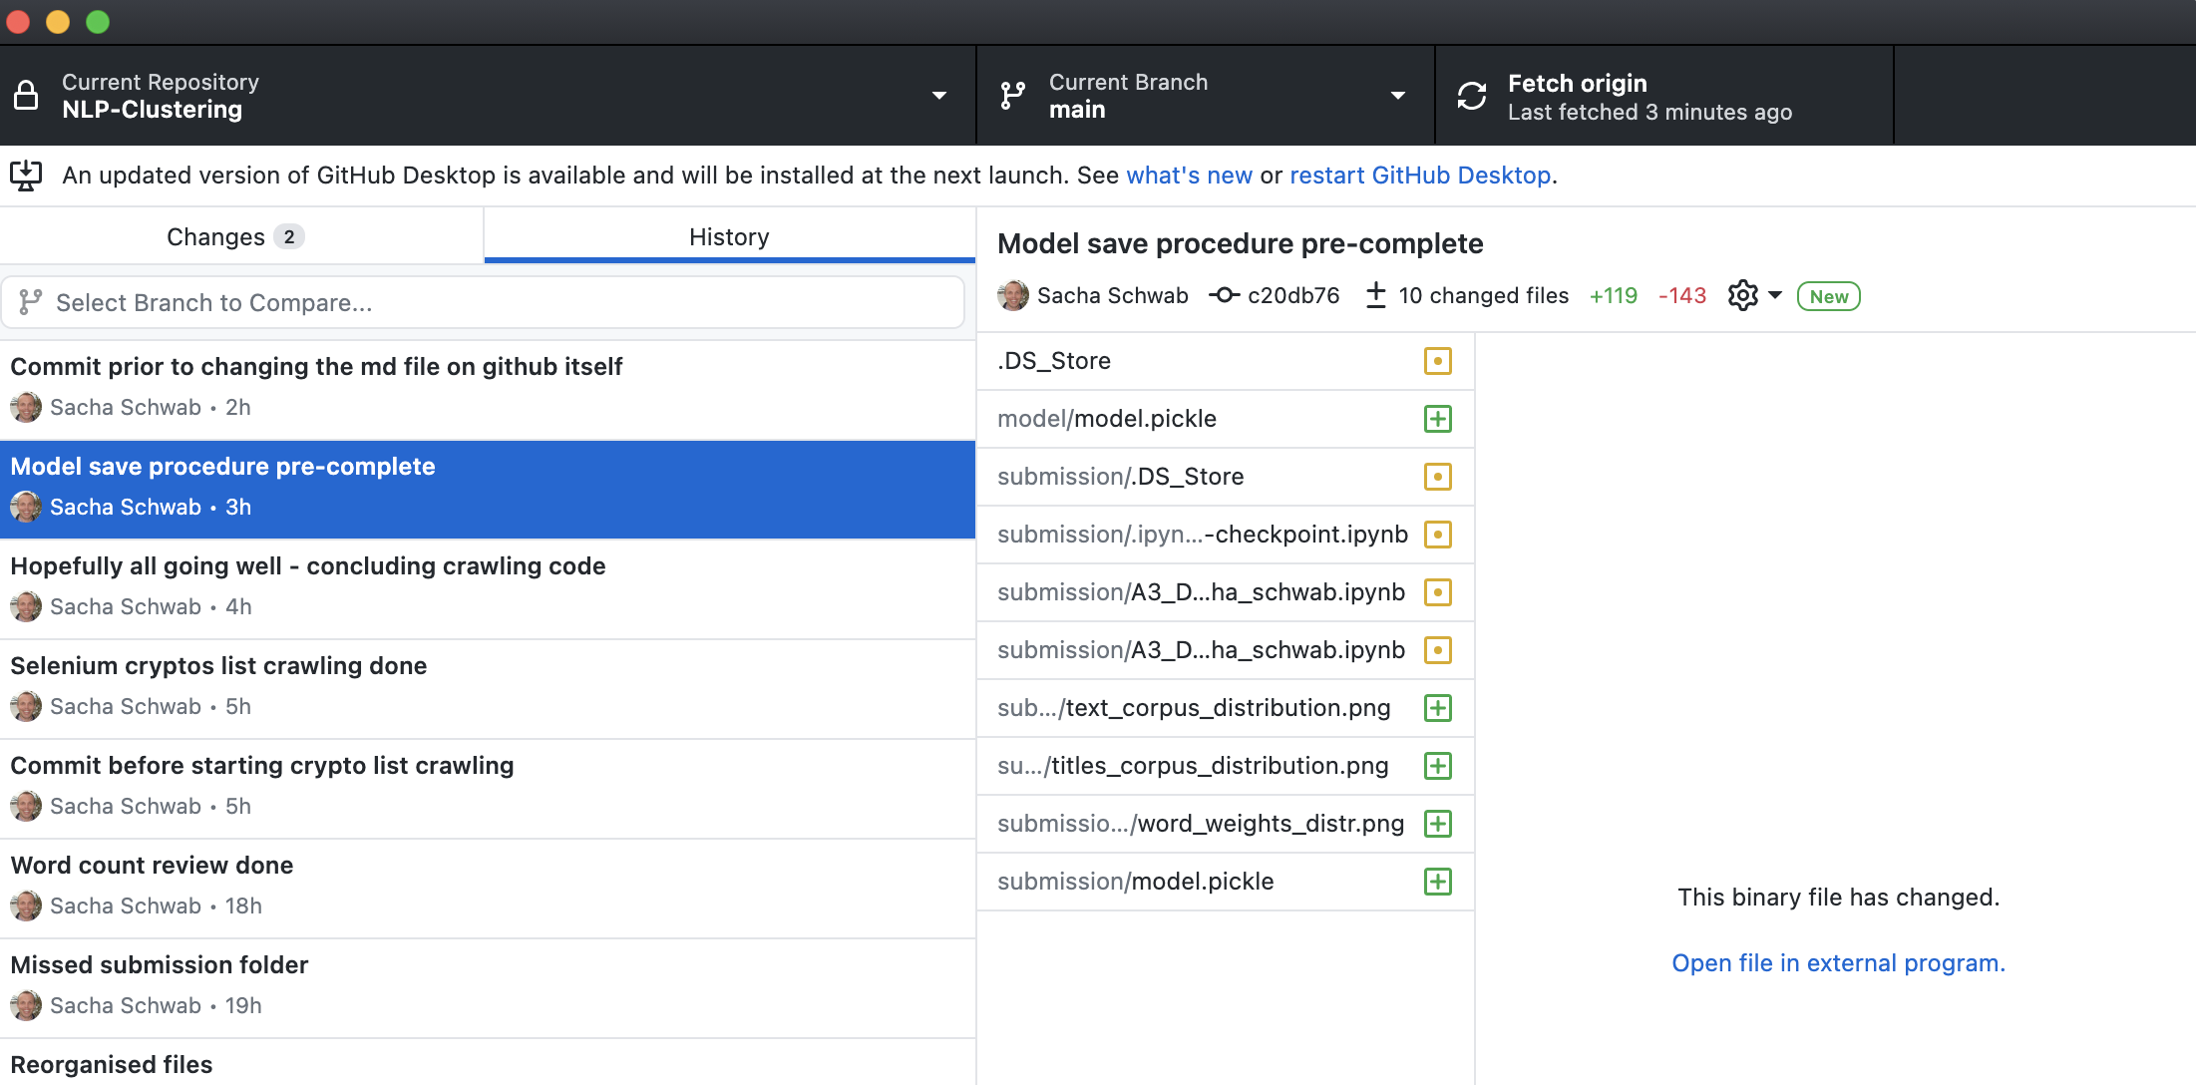
3. Code Management - Commits

Slide 6
4. Limitations Data

Slide 7



Webcrawler workflow
Webcrawler
main
page
request
https://finance.yahoo.com/cryptocurrencies/
Data
parse
article
urls (href)
csv
article
pages
requests
parse
title, body,
date
https://finance.yahoo.com/.../

